Slide 1
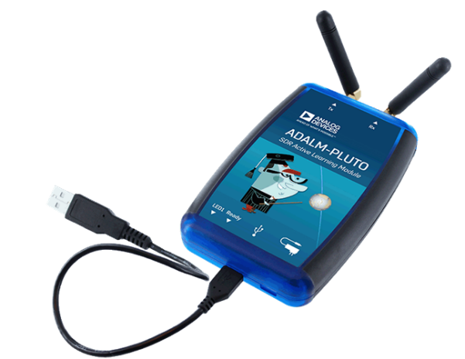

MS Thesis Presentation
Software Defined Radio Based Vector Network Analyzer for Characterization of RF Sensors and Circuits
Presented by: Ali Raza
Supervisor: Dr. Rashad Ramzan
Department of Electrical Engineering
National University of Computer Emerging Sciences Islamabad

Slide 2
Presentation Outline
Introduction
Problem Statement
Objectives
Background
Design Philosophy and Implementation
Measurement Results
Conclusion

Slide 3
Presentation Outline
Introduction
Problem Statement
Objectives
Background
Design Philosophy and Implementation
Measurement Results
Conclusion

Slide 4
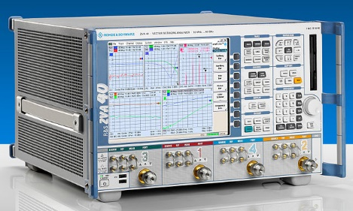
Vector Network Analyzer (VNA)
Measure the scattering parameters of electrical networks
Needs calibration for de-embedding the measurements

Slide 5
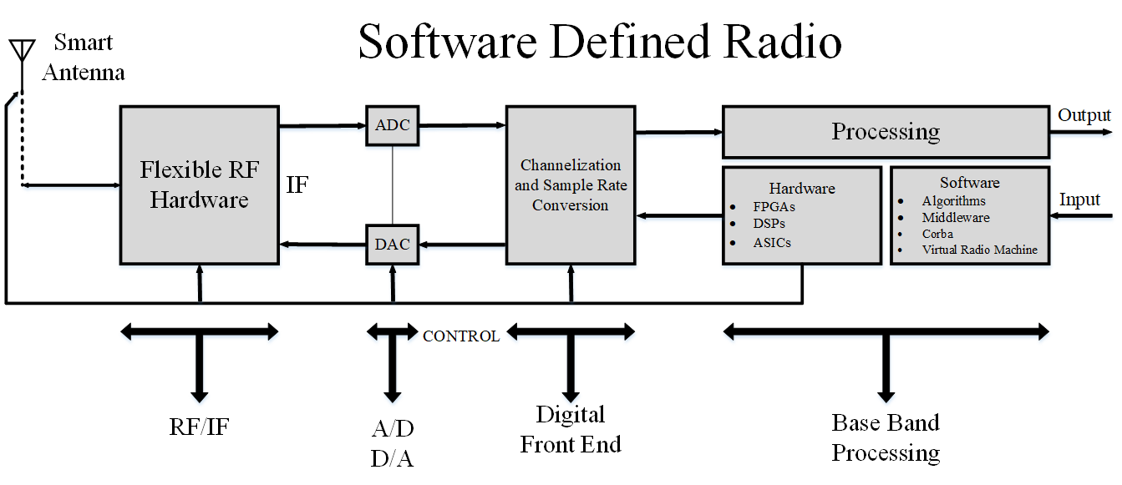
Software Defined Radio (SDR)
Replaces traditional hardware with programmable hardware
Can be used for various applications by software reconfiguration

Slide 6
Presentation Outline
Introduction
Problem Statement
Objectives
Background
Design Philosophy and Implementation
Measurement Results
Conclusion

Slide 7

Problem Statement
VNA is a very expensive instrument
Most essential instrument at RF laboratories
Low cost SDR can replace commercially available high cost VNAs for trivial applications

Slide 8
Presentation Outline
Introduction
Problem Statement
Objectives
Background
Design Philosophy and Implementation
Measurement Results
Conclusion

Slide 9
Objectives
Pluto SDR programing for desired reception
Processing the data in MATLAB/Simulink
Design and fabrication of a TRL calibration kit
Implementation of TRL algorithm
S-parameter measurement using Pluto SDR
Application of TRL calibration on the measured S-Parameters
Verification of measurement results with bench top reference VNA

Slide 10
Presentation Outline
Introduction
Problem Statement
Objectives
Background
Design Philosophy and Implementation
Measurement Results
Conclusion

Slide 11
Background
Joseph Mitola proposed the concept of SDR in early 90s [4]
Over the years SDR achieved great flexibility
SDR commercially used since last decade
SDR has been widely extended to different fields of electronics
[4]: J. Mitola, "Software Radios: Survey, Critical Evaluation and Future Directions," IEEE Aerospace and Electronic Systems Magazine, vol. 8, no. 4, pp. 25 - 36, 1993

Slide 12

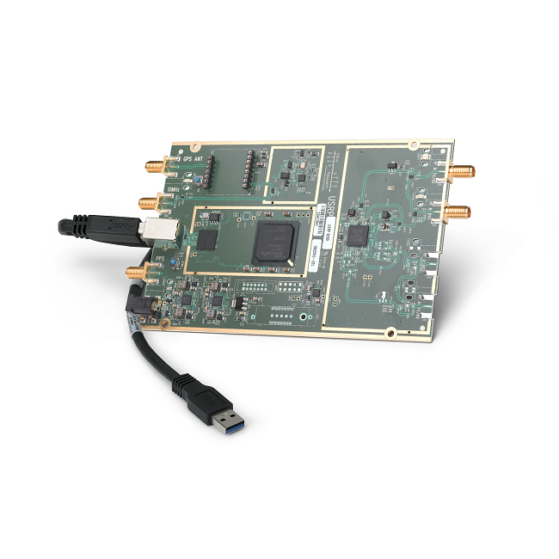
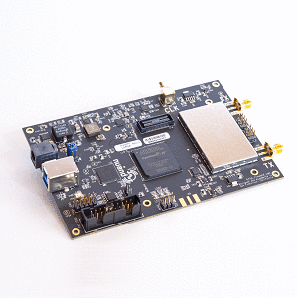
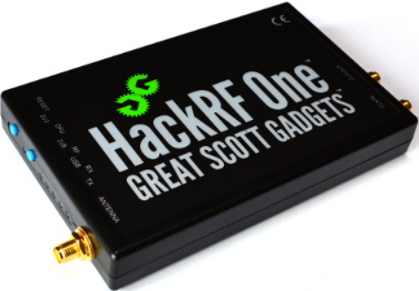
Some of Commercially Available SDR
ADALM-PLUTO SDR
USRP B200
BladeRF x 115
HackRF

Slide 13
Some of Commercially Available SDR
 | ADALM-PLUTO | HackRF | BladeRF x 115 | USRP B200
Operating Frequency | 325 MHz – 3.8 GHz (70 MHz – 6 GHz with software modification) | 1 MHz - 6 GHz | 300 MHz - 3.8 GHz | 70 MHz – 6 GHz
Bandwidth | 20 MHz | 20 MHz | 28 MHz | 56 MHz
Duplex | Half or full duplex | Half duplex | Hal or full duplex | Half or full duplex
BUS | USB 2.0 | USB 2.0 | USB 3.0 | USB 3.0
ADC/DAC Resolution | 12-bit | 8-bit | 12-bit | 12-bit
Million Samples per Second | 61.44 MSPS | 20 MSPS | 40 MSPS | 61.44 MSPS
Cost | $ 249 | $ 300 | $ 650 | $ 966

Slide 14
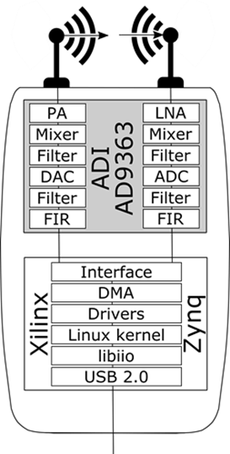
ADALM-PLUTO SDR
Portable self-contained RF learning module
Cost effective experimentation platform
One transmitter and one receiver
Receiver gain: 0 – 72 (dB)
Transmitter gain: -87.5 – 0 (dB)
MATLAB and Simulink support
USB powered

Slide 15
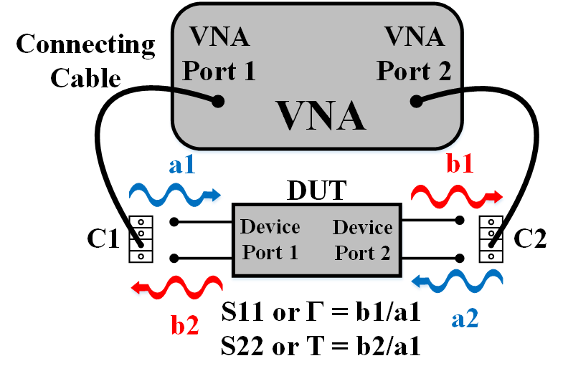
Scattering Parameters
Describes reflection and transmission responses of a DUT
N-ports DUT have N² elements in scattering parameters matrix
S11 represents reflection from port 1
S22 represents reflection from port 2
S21 represents transmission through port 2
S12 represents transmission through port 1

Slide 16
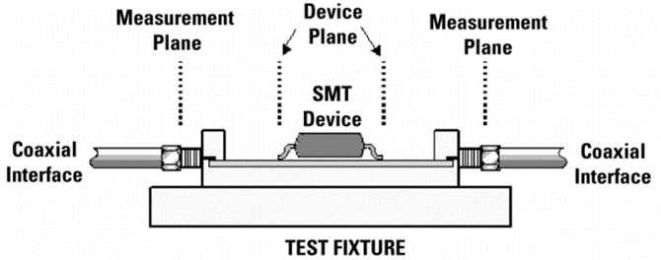
Calibration
Removing errors from measurement planes
Different types such as SOLT, LRM and TRL
Removes systematic errors which occur due to the non-ideal components in the test setup

Slide 17
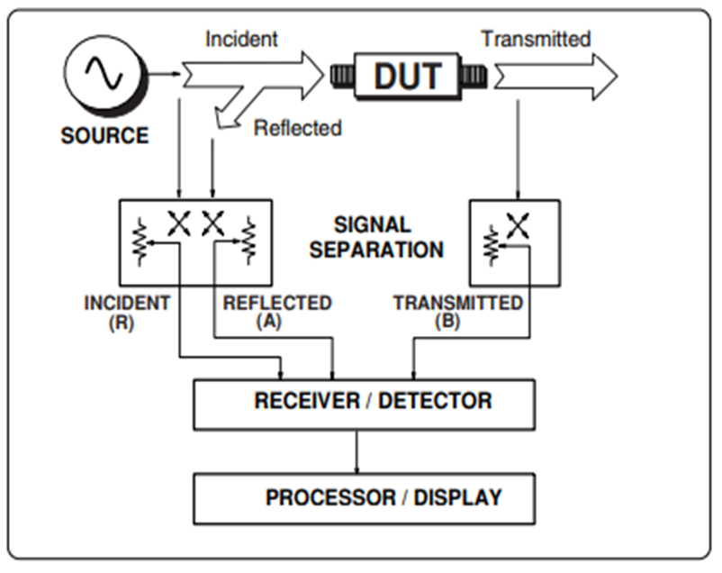
Classical VNA Architecture

Slide 18
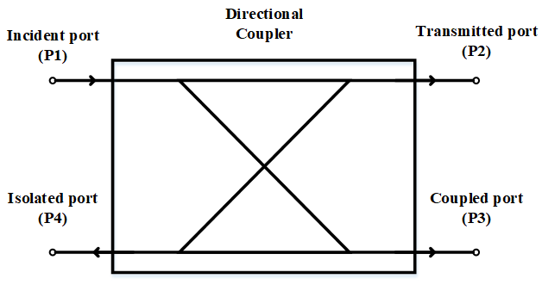

Coupling Signals
Directional coupler separates the incident and reflected signals at the input port of the DUT
They have a through path and a coupled path
An amount of power travelling along through path is coupled
Coupled power is defined by the coupling factor
$$Coupling factor \left(dB\right)= −10\log\left(\frac{Power coupled}{Power Incident}\right)$$

Slide 19
Presentation Outline
Introduction
Problem Statement
Objectives
Background
Design Philosophy and Implementation
Measurement Results
Conclusion

Slide 20
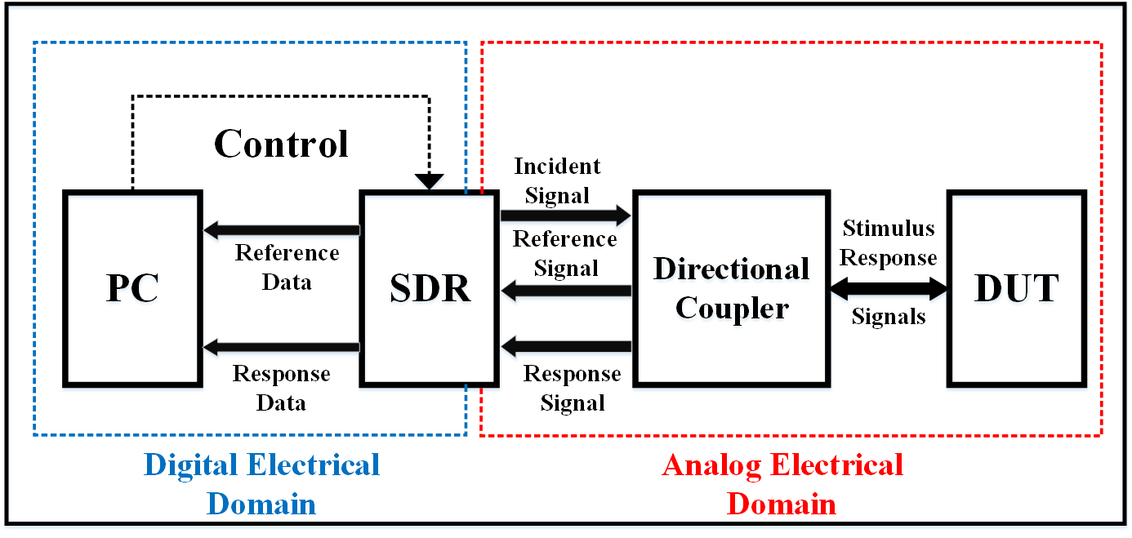
Proposed SDR Based VNA Architecture

Slide 21

Interfacing with MATLAB
A C++ code will interface the Pluto SDR with MATLAB
Saves the digital data of incident signal as a reference
Saves the digital data of reflected and transmitted signal as response
Ratio of the saved data to calculate the S-parameters
$$s11=\frac{b1}{a1} s21=\frac{b2}{a1}$$
$$s12=\frac{b1}{a2} s22=\frac{b2}{a2}$$

Slide 22
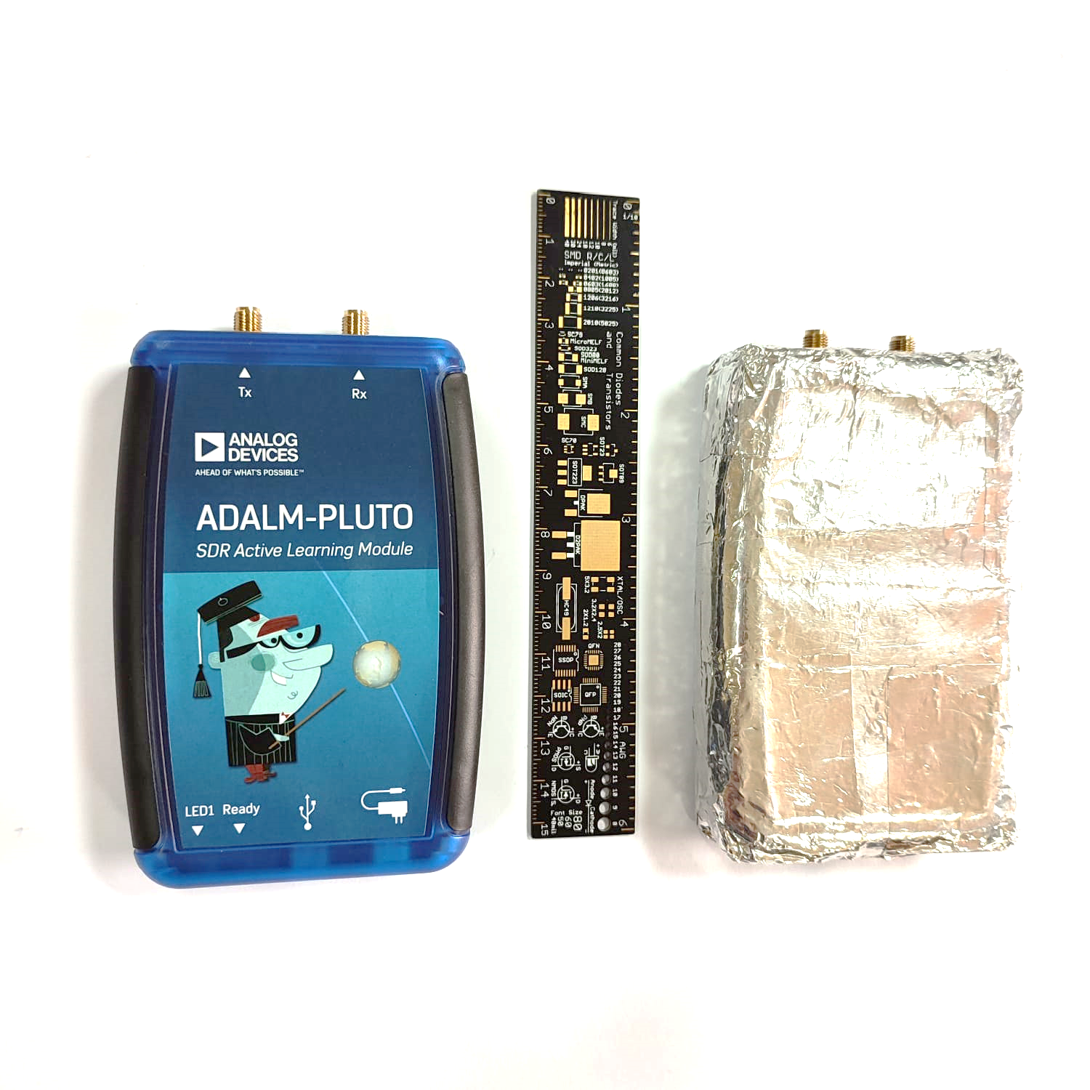
Pluto SDR Before and After RF Shielding

Slide 23
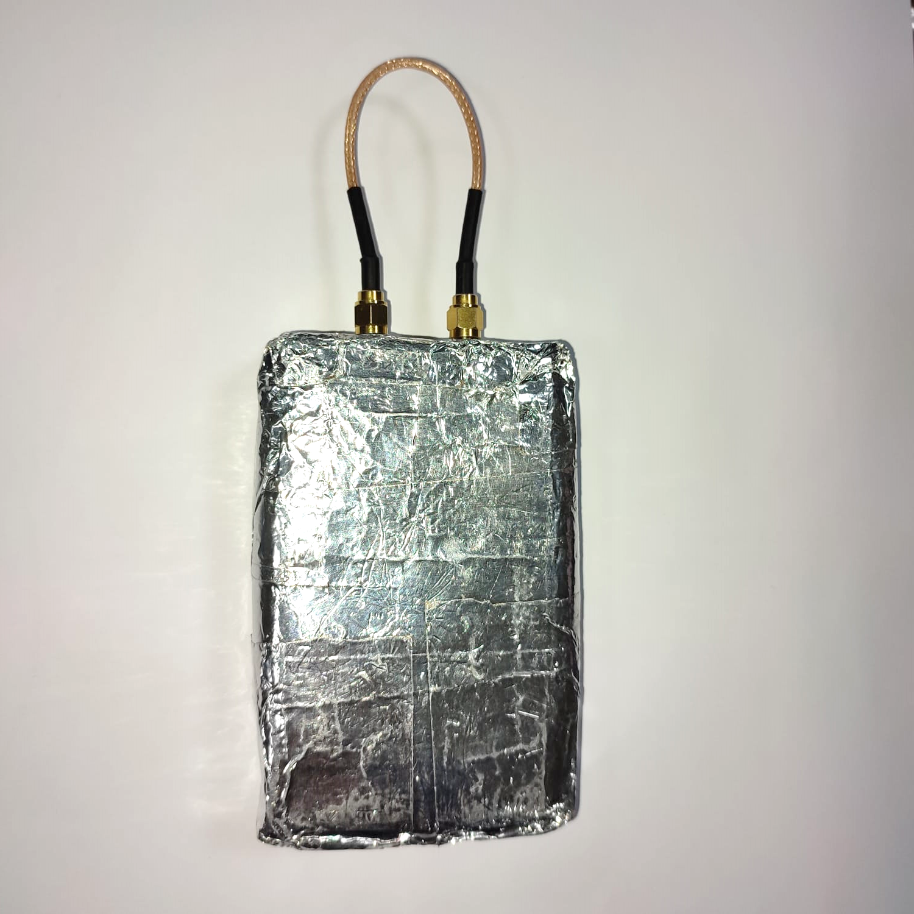
Loopback Mode

Slide 24
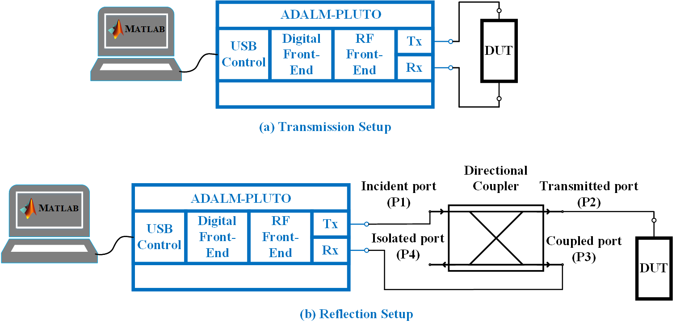
Measurement Setup

Slide 25
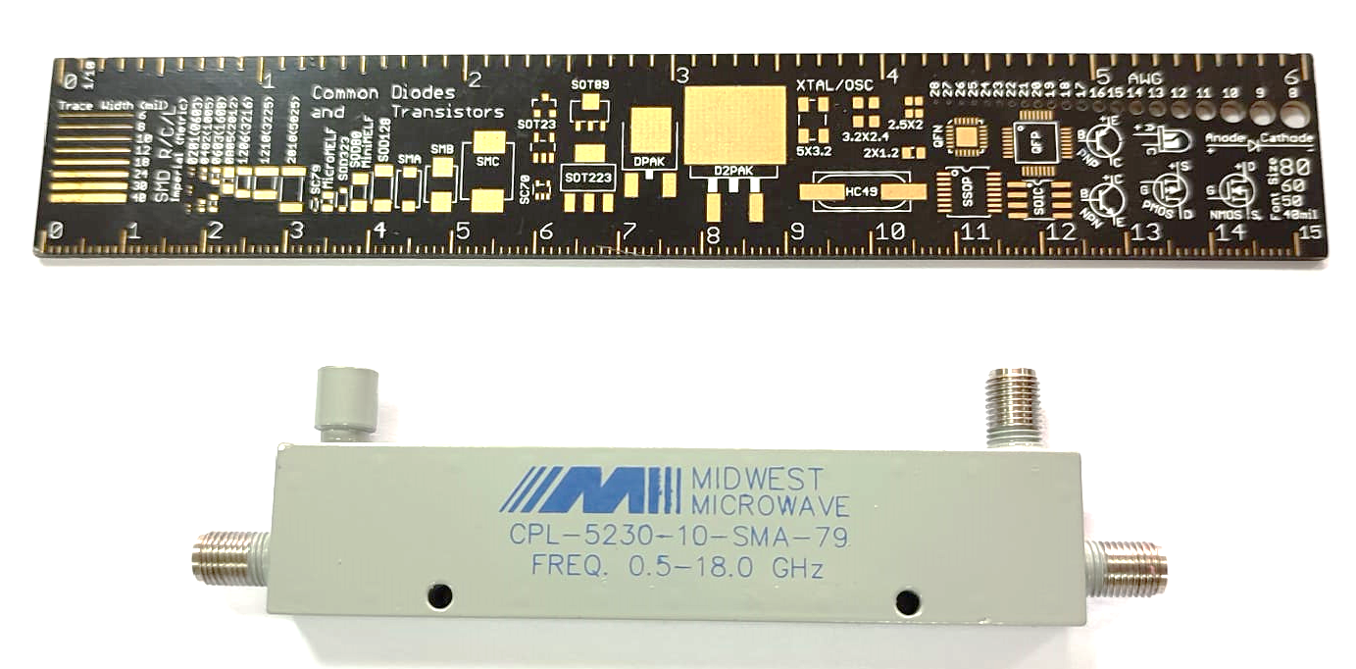
Directional Coupler
The directional coupler (CPL-5230-10-SMA-79) used is a product of Midwest Microwaves
It possesses inherently low insertion loss and VSWR with high directivity
It is an Ultra-Wideband device covering frequency range from 0.5 GHz to 18 GHz
Provides a 10 dB coupling output, 0.8 dB insertion loss, 15 dB directivity and 1.5 VSWR

Slide 26
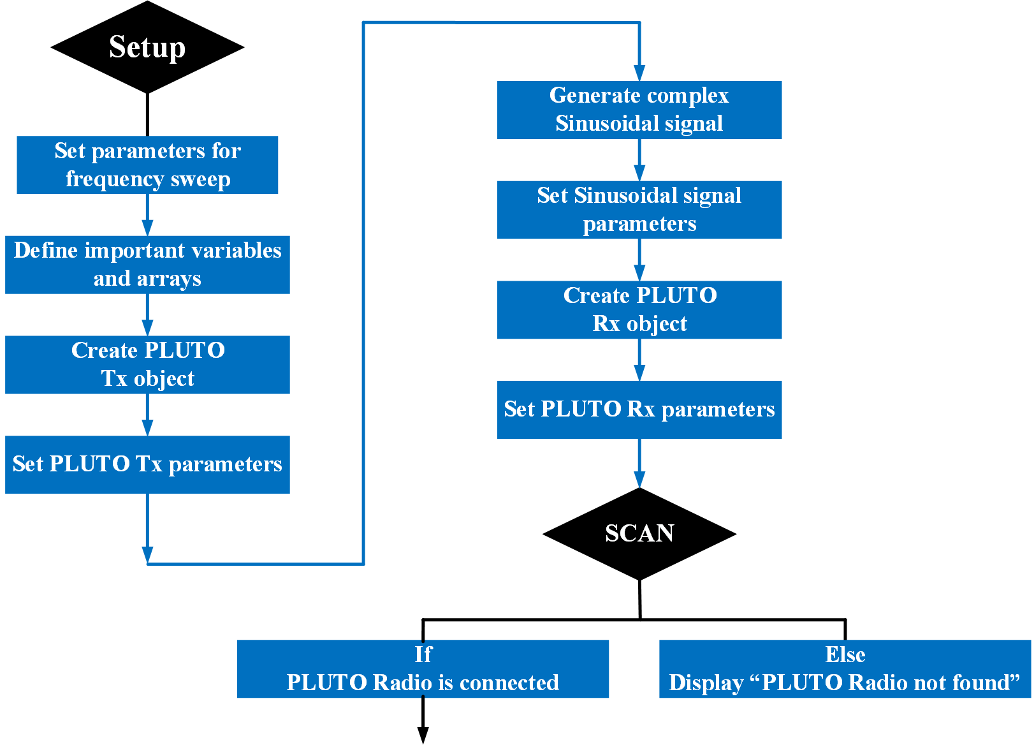
MATLAB Code Flowchart

Slide 27
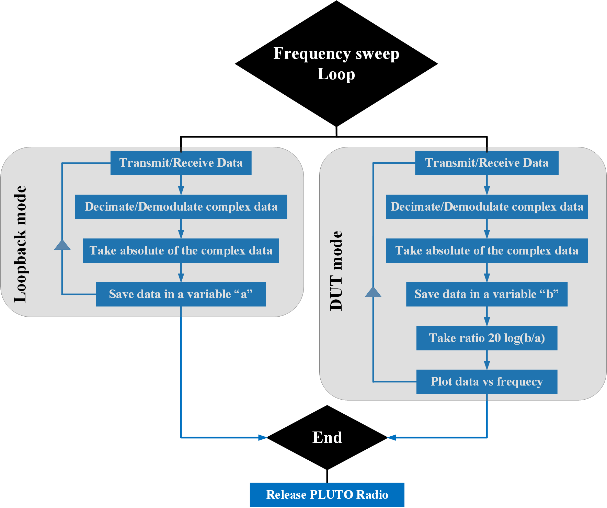
MATLAB Code Flowchart

Slide 28
System Parameters
SDR transmitter and receiver setting:
Frequency (500 MHz – 3800 MHz)
Frequency step (6.44 MHz) (512 points)
Tx/Rx baseband sample rate: 100 KHz
Rx samples per frame: 5000
Generated sinewave:
Power: 0 dB
Frequency: 5 KHz
Samples per frame: 5000

Slide 29
TRL Calibration
Through Reflect Line (TRL) calibration
Recommended for 1 to 10 GHz
Accuracy depends upon the quality of the fabricated kit
As the name implies, there are three standards
Through: Ideally it has a length close to zero, zero loss and zero reflection
Reflect: Any length, as long as it has a high reflection
Line: Recommended electrical length is ¼ λ

Slide 30
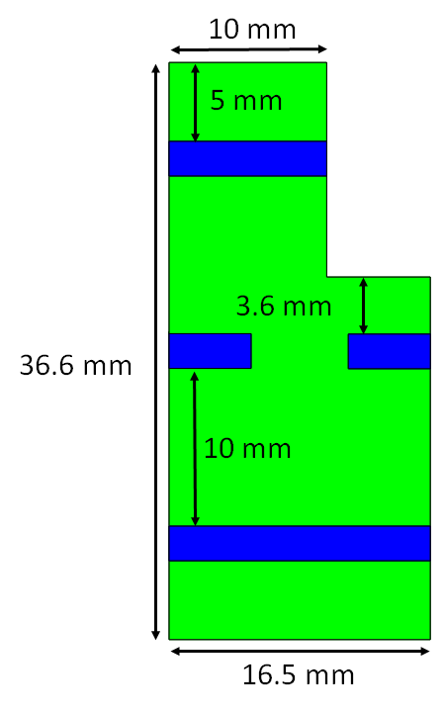
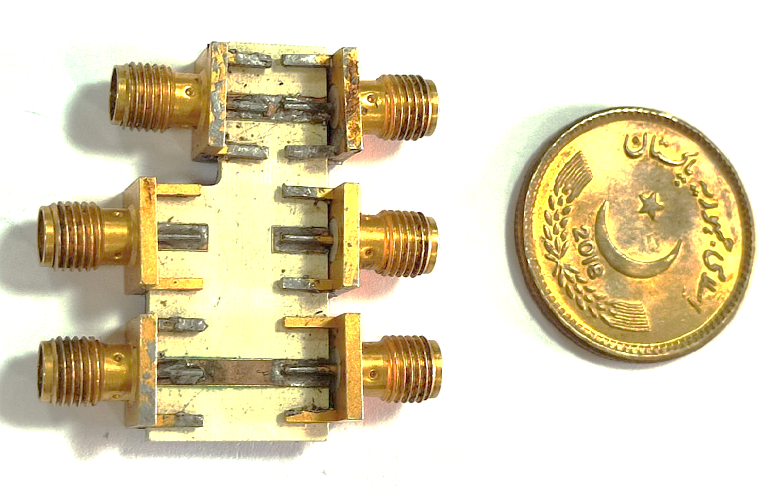
Fabricated TRL Kit
Substrate used: ROGERS RO4360G2
ε_{r}: 6.15
Thickness: 1.524 mm
Dissipation factor: 0.0038

Slide 31
S-Parameters of “Through” Standard

Slide 32
S-Parameters of “Reflect” Standard

Slide 33
S-Parameters of “Line” Standard

Slide 34
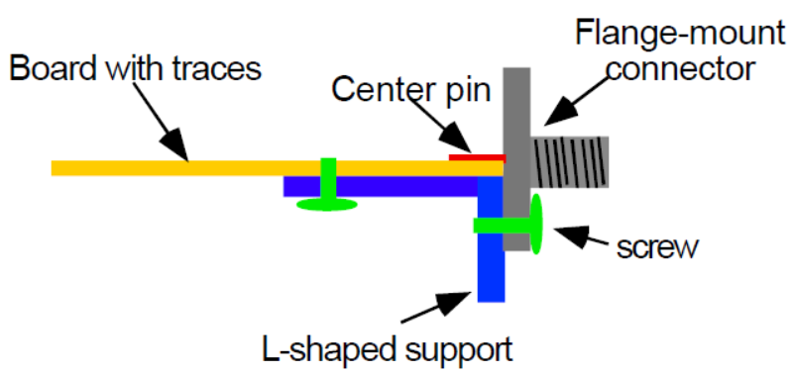
TRL Calibration Algorithm
Determines deviations from the ideal measurements
Deviations occur as a result of coaxial to micro strip transition
Two error boxes are introduced in the measurement reference plane
Obtain the parameters of these error boxes and remove their effect from the subsequent measurements.

Slide 35
Parameters of Error Boxes
Cascade of error box A and B by connecting the measurements planes 1 and 2 together using “through” standard
Terminating the measurement planes by connecting them with the “reflect” standard
Cascade of the error box A and B and the “line” yields the third
Finding the scattering parameters of all these combination it is possible to solve the individual parameters of the two error boxes and remove their effect from the measurements

Slide 36
TRL Calibration Algorithm
The calibration is performed on the basis of the TRL algorithm presented in the Journal Paper [1]
The algorithm performs the TRL calibration in two main steps
1st the S-parameters of the TRL standards and the DUT are measured
In the 2nd step the effects of the TRL text fixture are removed from the DUT measurements
[1]: G. F. Engen and C. A. Hoer, "Thru-Reflect-Line: An Improved Technique for Calibrating the Dual Six-Port Automatic Network Analyzer," IEEE Transactions on Microwave Theory and Techniques, vol. 27, no. 12, pp. 987 - 993, December 1979

Slide 37
TRL Calibration Algorithm
Step 1
Four matrices having s11, s21, s12, and s22 are created for the “line” and “through” standards and the DUT
Two matrices having s11 and s22 are created for the reflect standard
To calculate the two error boxes A and B presented in the article, we first find the wave cascading matrices for line, thru and the DUT represented as Rd, Rt and Rm in the article respectively

Slide 38
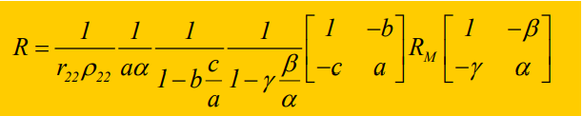
TRL Calibration Algorithm
Step 2
The calibrated s-parameter matrix of the DUT is found using the following equation
By finding all the unknown values in the equation above as explained in the TRL algorithm article we get the calibrated S-parameter matrix of the DUT.
All the unknown values are found by simplifying the mathematical equations explained in the article

Slide 39
Presentation Outline
Introduction
Problem Statement
Objectives
Background
Design Philosophy and Implementation
Measurement Results
Conclusion

Slide 40
Results
These results were carried out with the following settings
PLUTO SDR Settings
Frequency | 0.5 GHz – 3.8 GHz (512 points)
Frequency step | 6.44 MHz
Power | 30 dBm
Samples per frame | 5000
Moving average points | 3
VNA (MS46122B) Settings
Frequency | 0.5 GHz – 3.8 GHz (512 points)
Frequency step | 6.44 MHz
Power | 23 dBm max.
IFBW | 100 KHz
Averaging | Off

Slide 41
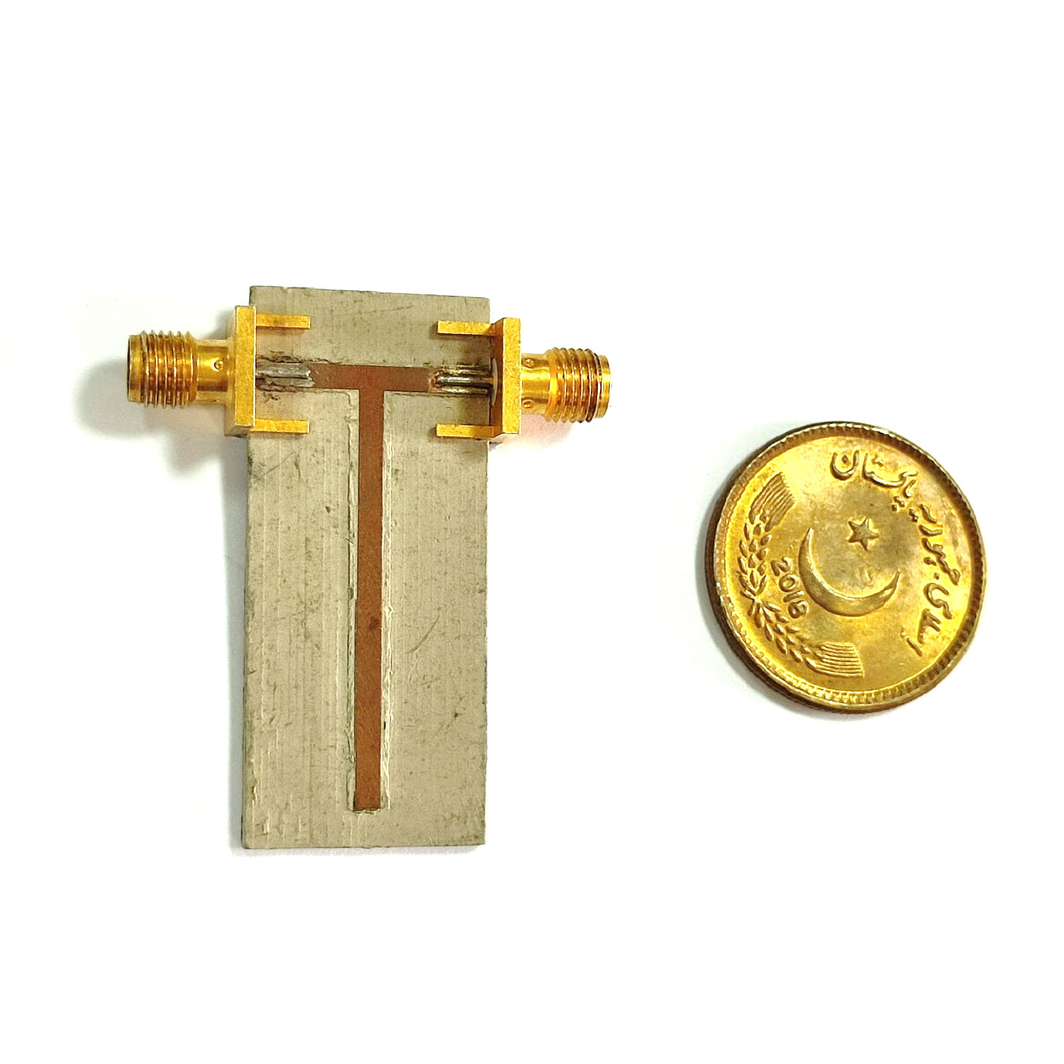
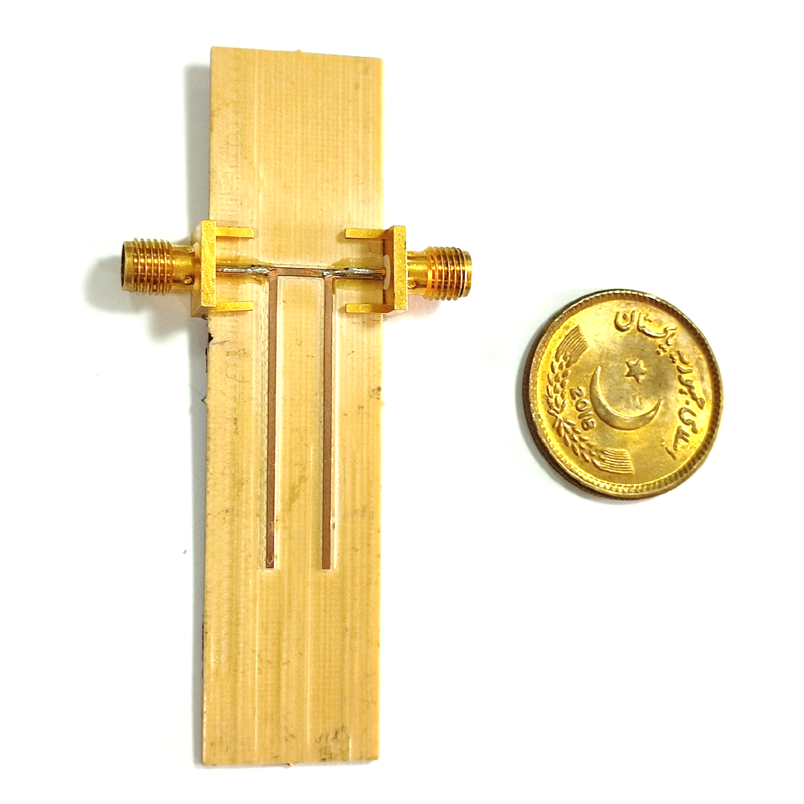
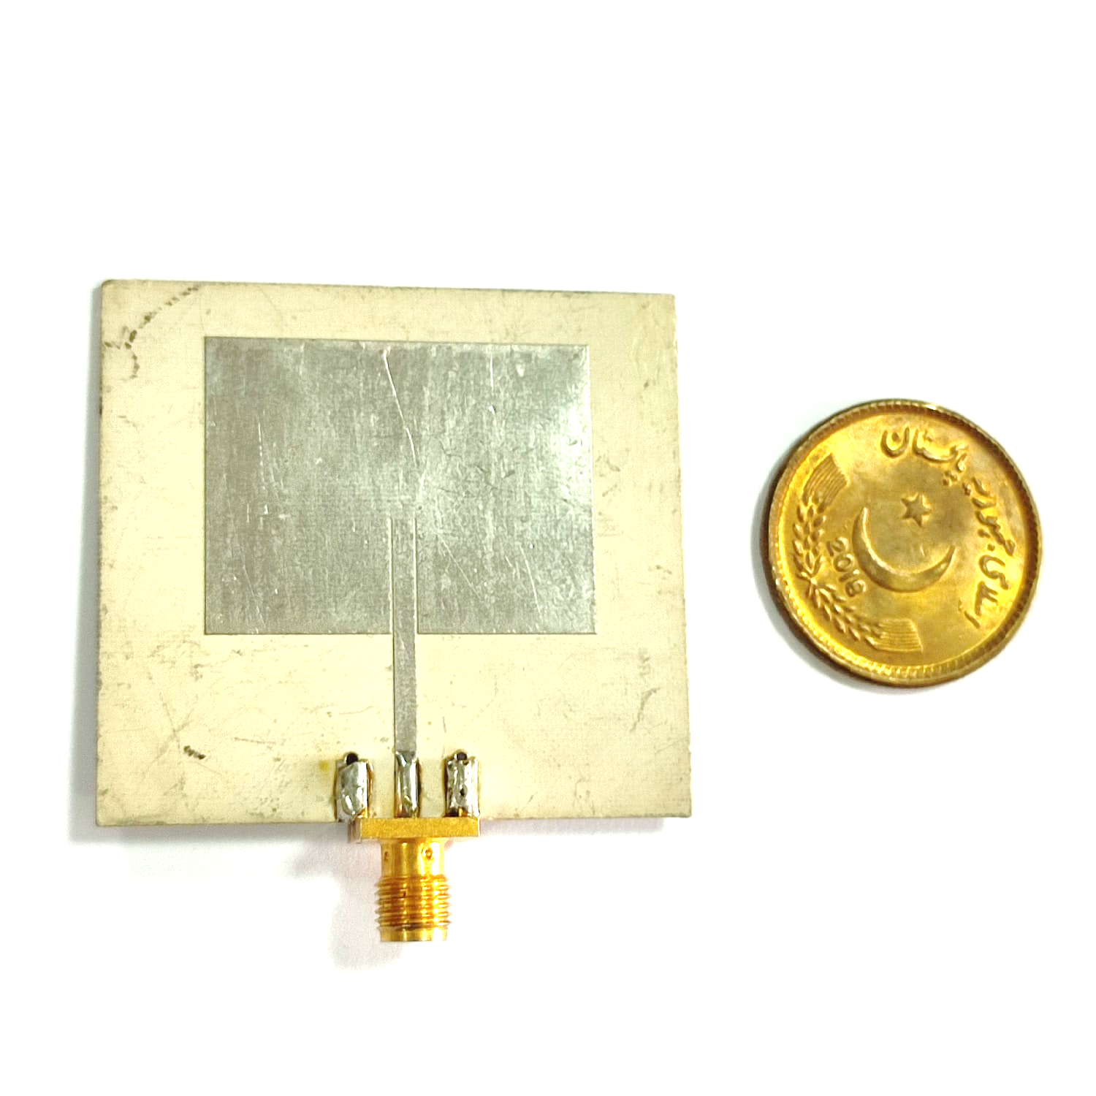
DUT for Measurements
Single Stub
Double Stub
Patch Antenna

Slide 42
TRL Calibration on SDR Measurements

Slide 43
Single Stub S11 Parameter

Slide 44
Single Stub S21 Parameter

Slide 45
Double Stub S11 Parameter

Slide 46
Double Stub S21 Parameter

Slide 47
Patch Antenna S11 Parameter

Slide 48
SDR and VNA Comparison

Slide 49
Single Stub S11 Parameter

Slide 50
Single Stub S21 Parameter

Slide 51
Double Stub S11 Parameter

Slide 52
Double Stub S21 Parameter

Slide 53
Patch Antenna S11 Parameter

Slide 54
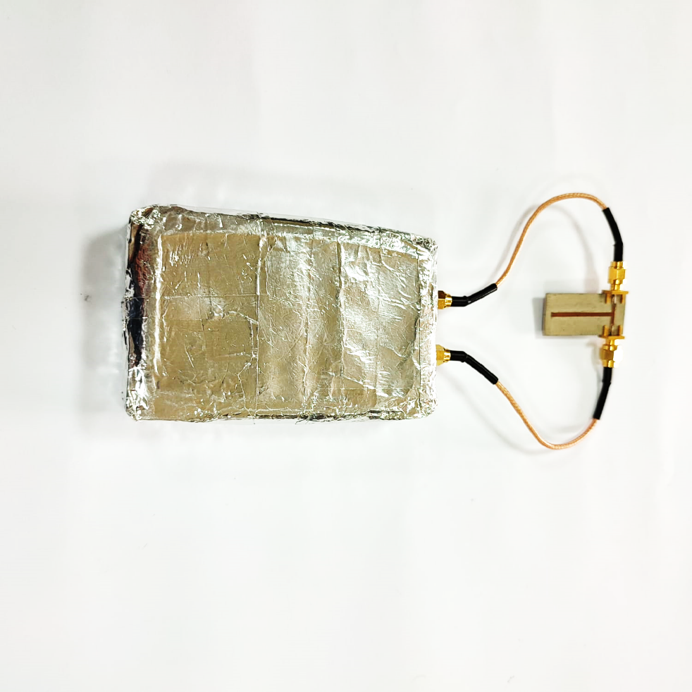
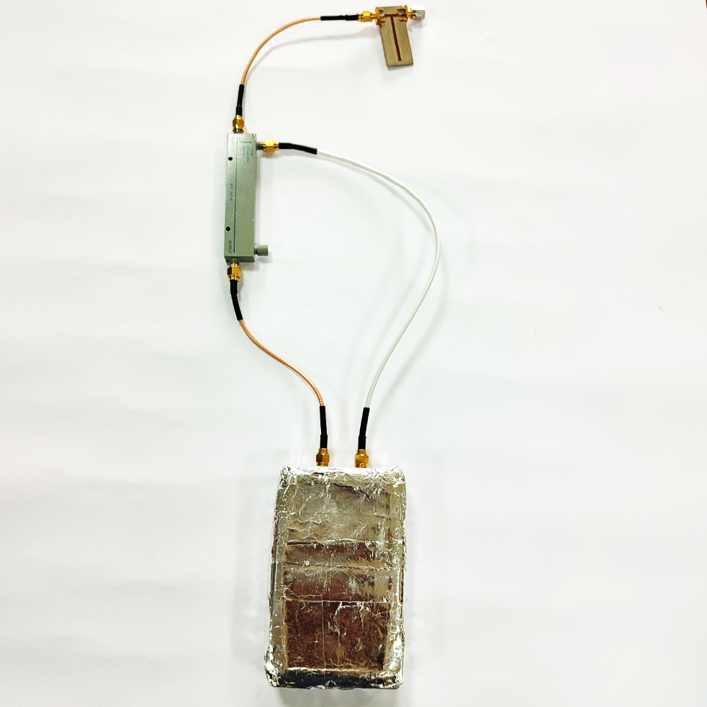
Pluto SDR Measurement Setup
Measurement of Single Stub Resonant Sensor
S21 Measurement Setup
S11 Measurement Setup

Slide 55
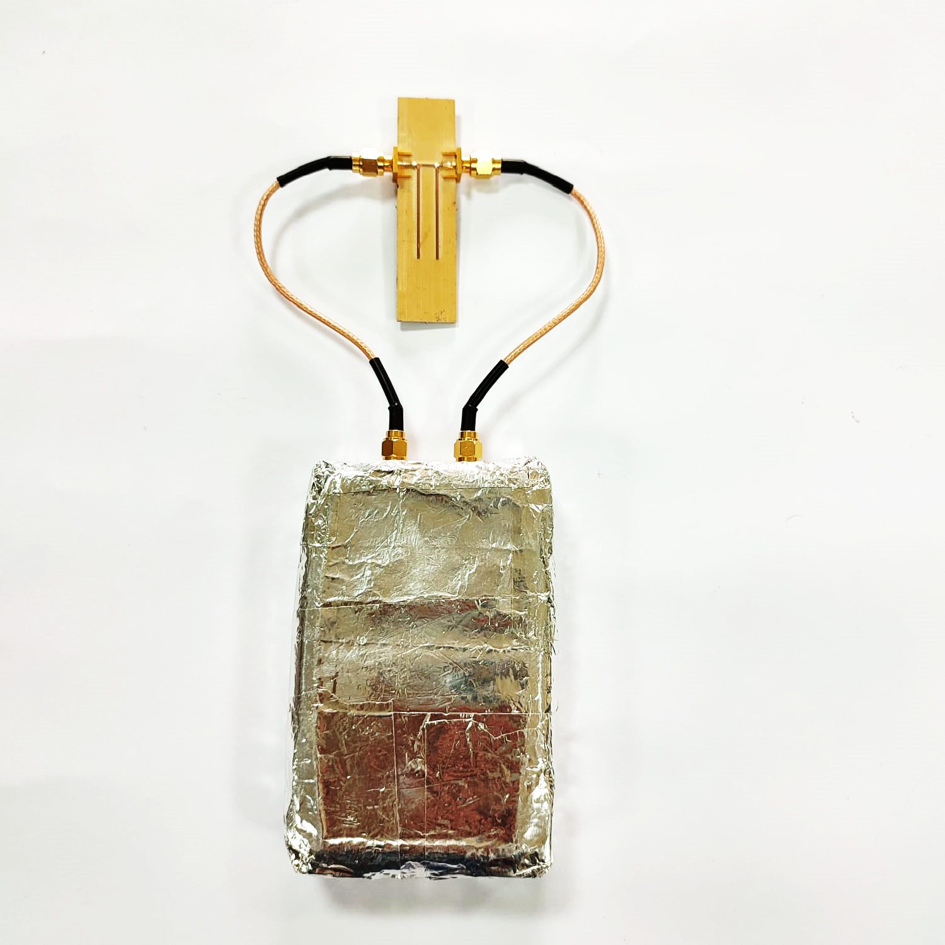
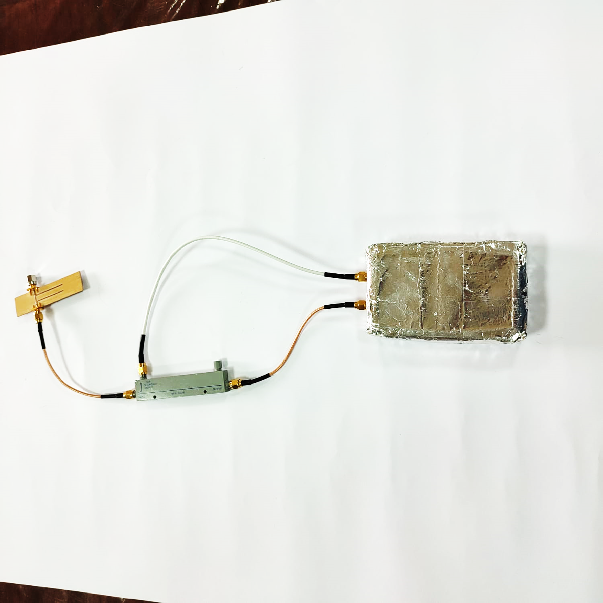
Pluto SDR Measurement Setup
Measurement of Double Stub Resonant Sensor
S21 Measurement Setup
S21 Measurement Setup

Slide 56
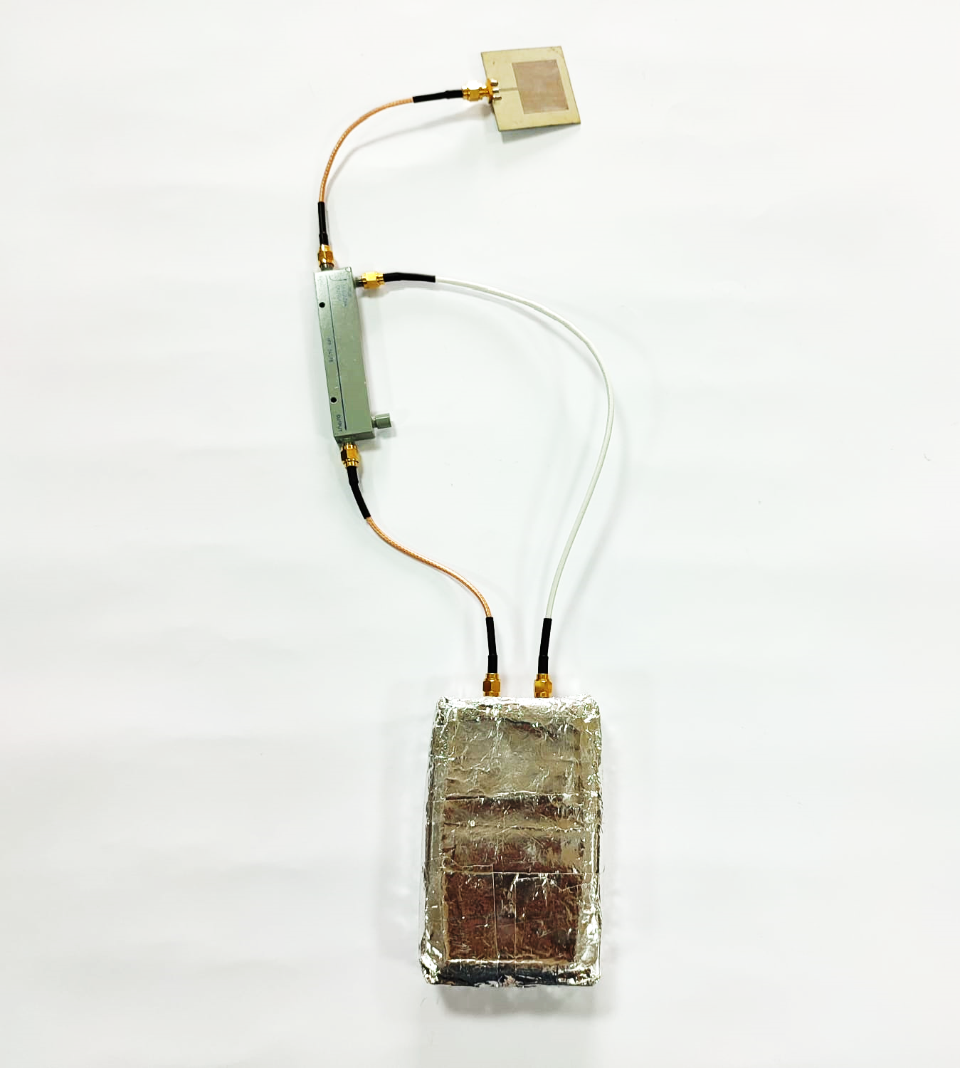
Pluto SDR Measurement Setup
Measurement of Patch Antenna
S11 Measurement Setup

Slide 57
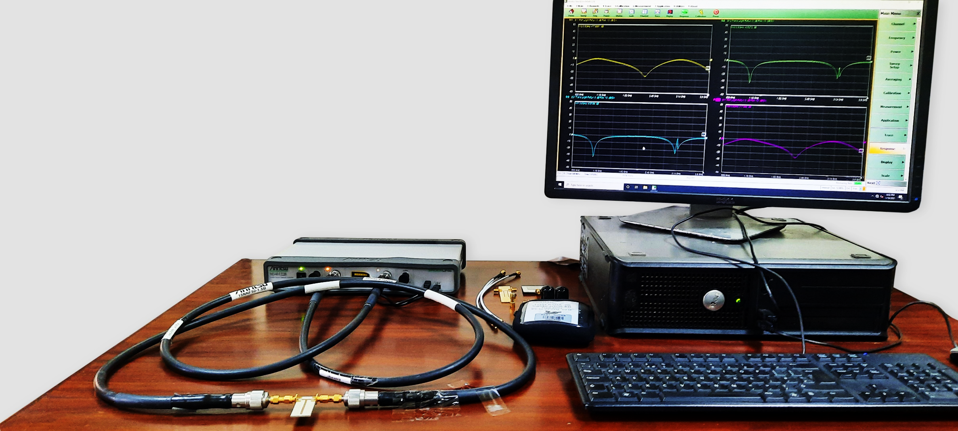
VNA Measurement Setup
Measurement of Single Stub Resonant Sensor

Slide 58
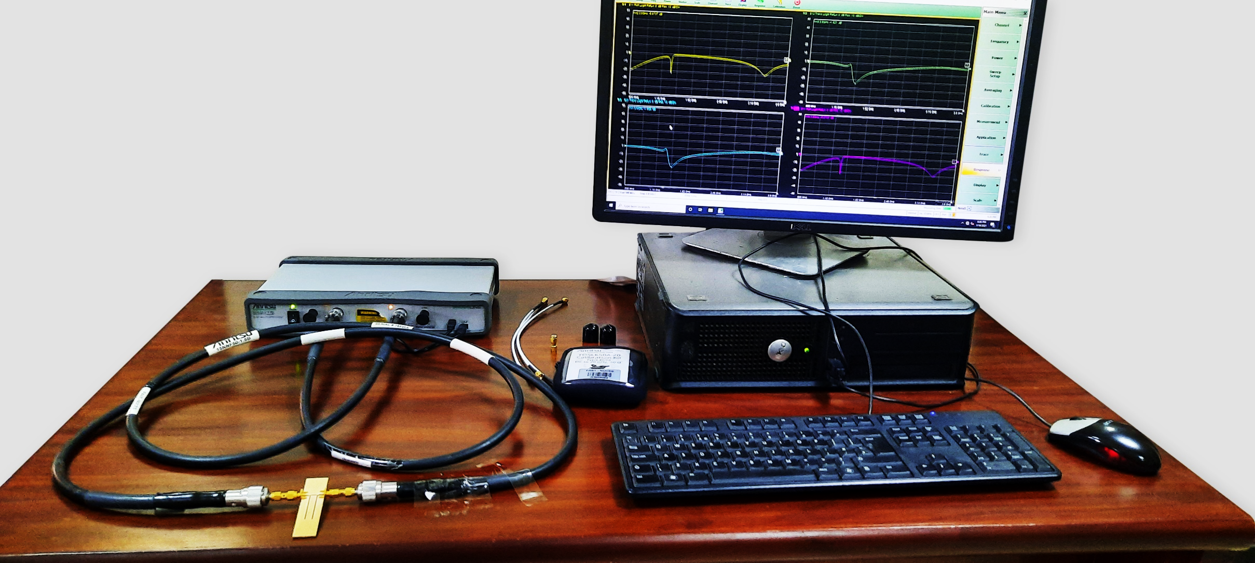
VNA Measurement Setup
Measurement of Double Stub Resonant Sensor

Slide 59
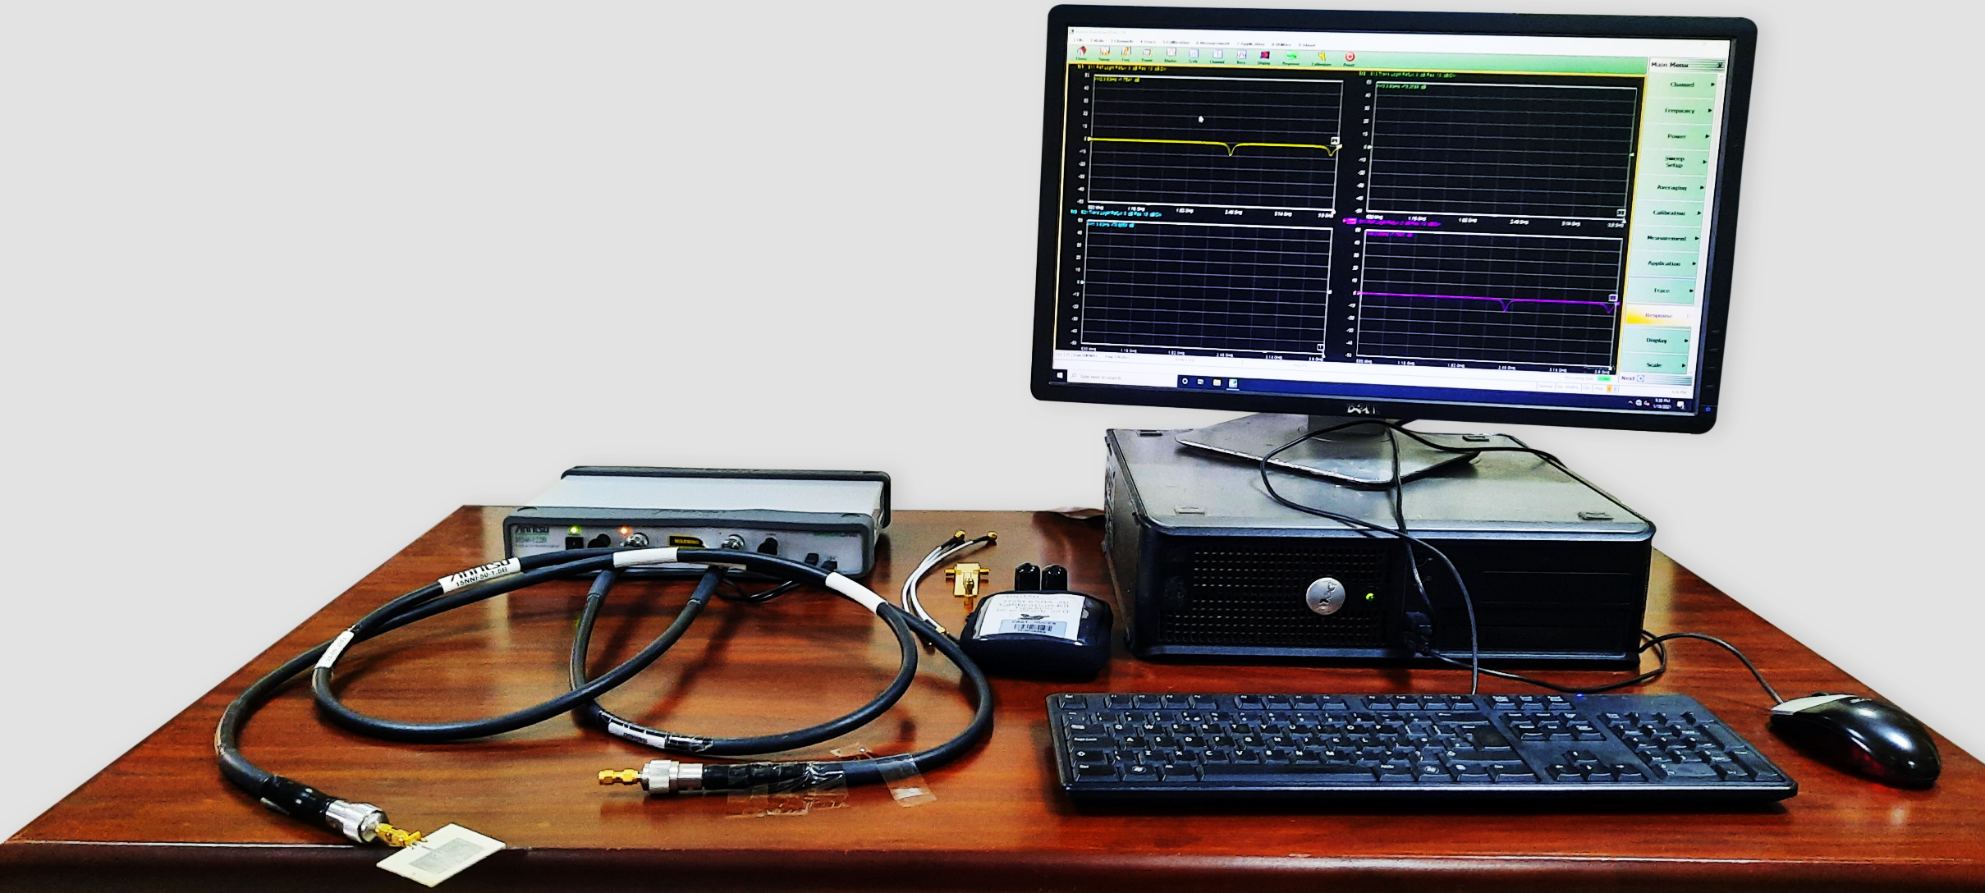
VNA Measurement Setup
Measurement of Patch Antenna

Slide 60
Presentation Outline
Introduction
Problem Statement
Objectives
Background
Design Philosophy and Implementation
Measurement Results
Conclusion

Slide 61
Conclusion
In this thesis we have presented a low cost SDR based VNA
The operating frequency of the proposed VNA is 0.5 GHz to 3.8 GHz
The SDR based VNA is calibrated using a TRL calibration kit
The performance of the proposed VNA has been compared with a commercial VNA from Anritsu
A quite good resemblance is observed between the results obtained from SDR based and commercial VNA
Thus, it can be used as a cheap instrument in the research laboratories and educational institutes for characterization of RF devices

Slide 62
References
G. E. a. C. Hoer, "Thru-Reflect-Line: An Improved Technique for Calibrating the Dual Six-Port Automatic Network Analyzer," IEEE Transactions on Microwave Theory and Techniques, vol. 27, no. 12, pp. 987 - 993, 1979
A. Estrada, "The vector network analyzer - an essential tool in modern ATE measurements," IEEE Instrumentation & Measurement Magazine, vol. 15, no. 4, pp. 22-26, 2012
D. Rytting, "ARFTG 50 Year Network Analyzer History," in 2008 71st ARFTG Microwave Measurement Conference, Atlanta, 2008
J. Mitola, "Software Radios: Survey, Critical Evaluation and Future Directions," IEEE Aerospace and Electronic Systems Magazine, vol. 8, no. 4, pp. 25 - 36, 1993

Slide 63
Thank you

